Slide 1
Topic: Ratios EQ: How do I simplify ratios?
Year 11 Essentials

Slide 2
Things Required For This Lesson
Interactive Notebook
Textbook: Interleaved Maths Essential Connections
Ruler, Red Pen, Pencil, Pens, Scientific Calculator
Growth mindset

Slide 3

24
7
30
Topic: Ratios
Date: /03/2021
EQ: How do I simplify ratios?
WICOR
This Photo by Unknown Author is licensed under CC BY-SA

Slide 4
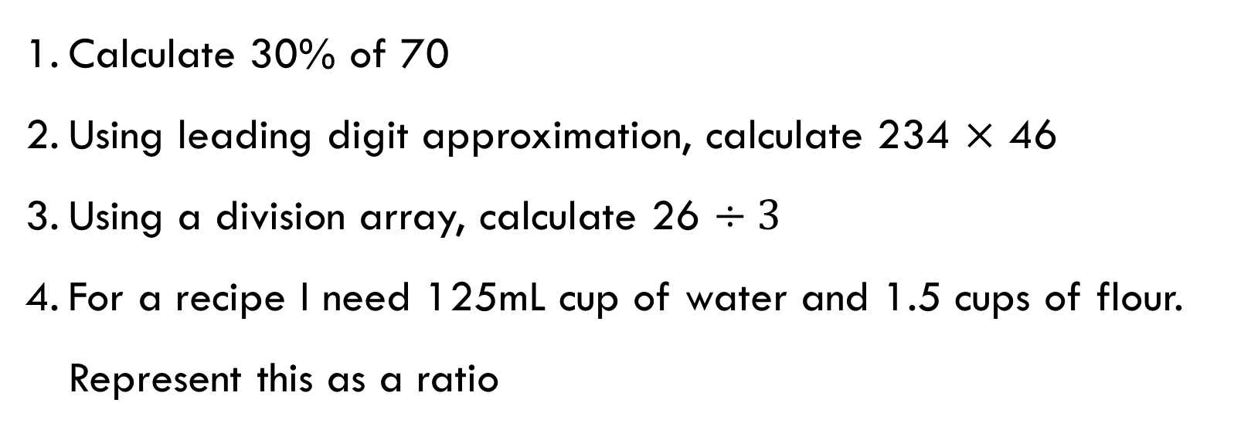
Topic: Ratios
EQ: How do I simplify ratios?
Calculate 30% of 70
Using leading digit approximation, calculate 234 $×$ 46
Using a division array, calculate 26 $÷3$
For a recipe I need 125mL cup of water and 1.5 cups of flour. Represent this as a ratio

Slide 5
24
7
30
Topic: Ratios
EQ: How do I simplify ratios?
How to simplify ratios?
Ratios can be simplified by finding a common factor.
E.g. instead of a ratio of 2:6 we can halve both numbers to become 1:3
WICOR

Slide 6
Think pair share
25mL oil to 1 cup of water
Do we need to change the measurement system to be the same?
Is there a common factor between the amounts in the ratio
What simplified ratio could we use?
Yes; 25mL oil to 250mL water. This is represented as 25:250
Yes; both can be divided by 25
The simplified ratio would be 1: 10

Slide 7
Practice: (LHS)
Simplify the following:
Make decimals whole by multiplying by multiples of base 10 (10, 100, 1000, 10000…)
32 : 8
15 : 40
3.6 : 8.8
2.15 : 3.2
13m : 250cm

Slide 8
Practice: Complete Set A and the complex application on page 32

Slide 9
Exit Pass
1. Simplify the following:
15: 60
9: 39
25: 110

Slide 10

Thank you
Keep up the good work!
"Self-belief and hard work will always earn you success.“
-Virat Kohli

